Slide 1
Computer Vision
Part 1: Neural Networks
ADF – Start 08:30

Slide 2

Agenda
Part 1: Neural Network
Part 2: Convolutional Neural Networks
Computer Vision

Slide 3
So Far…
$$f\left(x , W \right)=Wx +b$$
Score function
Loss Function
SVM loss function
Softmax loss function
$$L=\frac{1}{N} \sum_{i=1}^{N}{L_{i}}$$
$$L_{i}= \sum_{j≠y_{i}}{\max\left(0, s_{j}−s_{y_{i}}+1\right)}$$
$$L_{i}=− \log{(\frac{e^{s_{y_{i}}}}{\sum_{j}{e^{s_{j}}}})}$$
Computer Vision

Slide 4
Neural Networks
Computer Vision

Slide 5
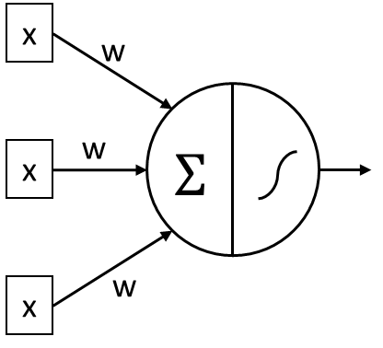
Neuron
The main component of Neural Network
Which is actually just a simple linear function (logistic regression)
Computer Vision

Slide 6
Neural Network
Neural Network is just a series (stacks) of neuron
Each connection between neuron is precedented by a non-linear function
Computer Vision

Slide 7
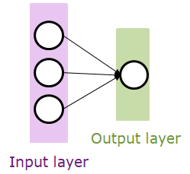
Neural Network
(Before) Linear Score Function
(Now) 2-Layer Neural Network
$$\hat{y}=W.x$$
-
$$\hat{y}=W_{2}.f\left(W_{1}.x\right)$$
-
-
Output layer
Input layer
Hidden layer
Computer Vision
Notes:
2-layer NN : more mathematical complex of X
Nonlinearity (activation function), here, we use maxout

Slide 8
Neural Network
(and further) 3-Layer Neural Network
$$\hat{y}=W_{3}.f⁡(W_{2}.f\left(W_{1}.x\right))$$
-
-
-
Output layer
Input layer
Hidden
Layer 1
Hidden
layer 2
Computer Vision
Notes:
2-layer NN : more mathematical complex of X
Nonlinearity (activation function), here, we use maxout

Slide 9
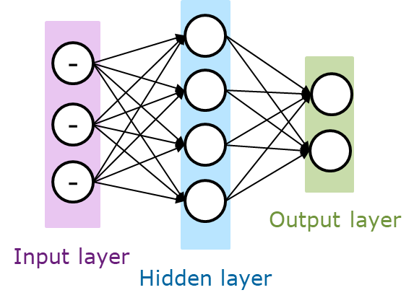
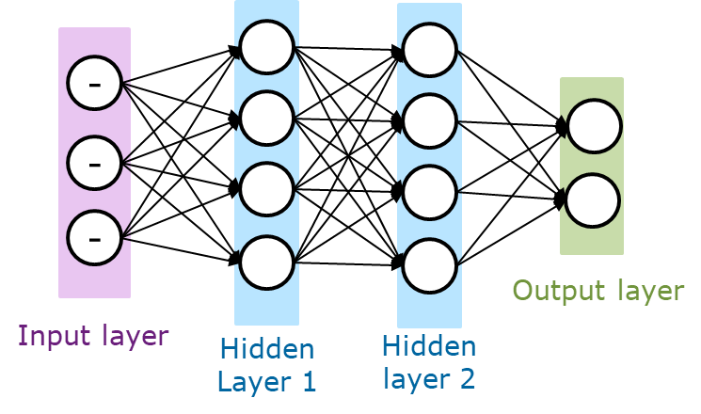
Neural Network Naming
1-layer Neural Net
Single Layer Perceptron
2-layer Neural Net
1 Hidden Layer Neural Net
3-layer Neural Net
2 Hidden Layer Neural Net
And so on
Computer Vision

Slide 10
Neural Network Naming
Layer is where the weights attached
A network with two or more layers is referred to as a Multi-Layer Perceptron (MLP)
Computer Vision

Slide 11
Layer Number and Size
Increase the size and number == increase the network capacity
Neural Networks with more neurons can express more complicated functions
Can learn to classify more complicated data
Tradeoff:
More likely to overfit the training data
Computer Vision

Slide 12
Gradient in Neural Network
Computer Vision

Slide 13

Single Layer Derivative, Easy
$$f\left(Wx+b\right)$$
target
$$\hat{y}$$
$$y$$
$$\frac{∂L}{∂\hat{y}}$$
gradients
Easy calculation
$$\frac{∂L}{∂w}$$
Computer Vision
Notes:
If it’s only one layer, we can simply write the derivative

Slide 14
Multi Layer Derivative?
$$\frac{1}{1+e^{−\left(W_{3}\frac{1}{1+e^{−\left(W_{2}\frac{1}{1+e^{−\left(W_{1}x\right)}}\right)}}\right)}}$$
$$f\left(W_{3}f\left(W_{2}f\left(W_{1}x\right)\right)\right)=$$
-
target
$$\hat{y}$$
$$y$$
-
$$\hat{y}$$
$$y$$
-
$$\frac{∂L}{∂\hat{y}}$$
Output layer
Input layer
Hidden
Layer 1
Hidden
layer 2
$$\frac{∂L}{∂W}= ???$$
Complicated to calculate as a whole,
Modifying any function require re-derive from scratch
Computer Vision
Notes:
If it’s only one layer, we can simply write the derivative

Slide 15
MLPs = Stacks of Linear Functions
Each layer use the same function
Remember that when calculating gradient, we get $∂w$ and $∂x$
$$a_{1}=f\left(W_{1}x\right)$$
$$a_{2}=f\left(W_{2}a_{1}\right)$$
$$\hat{y}=f(W_{3}a_{2})$$
target
-
$$\hat{y}$$
$$y$$
-
$$\hat{y}$$
$$y$$
-
Computer Vision
Notes:
If it’s only one layer, we can simply write the derivative

Slide 16
Back Propagate the Gradient
Calculate gradient one-by one
Output Gradient = external gradient * local gradient
$$a_{1}=f\left(W_{1}x\right)$$
$$a_{2}=f\left(W_{2}a_{1}\right)$$
$$\hat{y}=f(W_{3}a_{2})$$
target
-
$$\frac{∂L}{∂a_{1}}$$
$$\frac{∂L}{∂a_{2}}$$
$$\hat{y}$$
$$y$$
-
$$\hat{y}$$
$$\frac{∂L}{∂\hat{y}}$$
$$y$$
-
$$\frac{∂L}{∂W_{3}}$$
$$\frac{∂L}{∂W_{1}}$$
$$\frac{∂L}{∂W_{2}}$$
Easy calculation
Computer Vision
Notes:
If it’s only one layer, we can simply write the derivative

Slide 17
API Building
Computer Vision

Slide 18
Forward/Backward API
*rough pseudo code
class net(object):
# ...
def forward(inputs):
# 1. process inputs to input layer
# 2. forward computational graph
# ...
for layer in layers:
layer.forward()
return loss
def backward():
for layer in reversed(layers):
# backprop (chain rule applied)
layer.backward()
return gradients
Computer Vision

Slide 19
Forward/Backward API
x
class MultiplyLayer(object):
# ...
def forward(x, y):
z = x*y
return z
def backward(dz):
dx = ??
dy = ??
return dx, dy
*
z
y
x, y, z are scalars
$\frac{∂L}{∂z}$ (loss)
$$\frac{∂L}{∂x}$$
$$\frac{∂L}{∂y}$$
Gradient $x$ and $y$
Computer Vision

Slide 20
Forward/Backward API
x
class MultiplyLayer(object):
# ...
def forward(x, y):
z = x*y
self.x = x # need to keep these
self.y = y
return z
def backward(dz):
dx = self.y * dz # [dz/dx * dL/dz]
dy = self.x * dz # [dz/dy * dL/dz]
return dx, dy
*
z
y
x, y, z are scalars
Complete API by storing intermediate gradient that needed in backward pass
Computer Vision
Notes:
Note that x and y is retained
Need to remember, as the forward pass, same value, like the inputs, need to be remembered to use in the backward pass
So as the forward pass go through the layers, the cache will ballooning up, and it will released as the backward pass

Slide 21
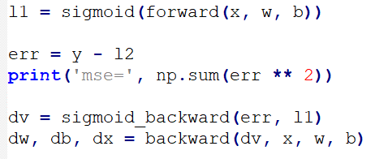
Single Layer using API
Computer Vision

Slide 22
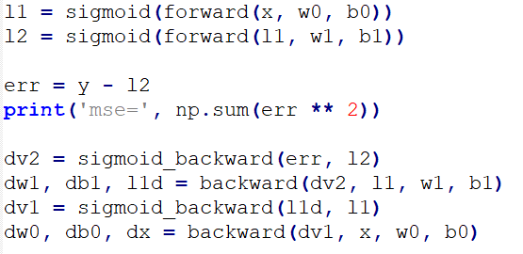
Multi Layer Perceptron
-
-
-
Output layer
Input layer
Hidden layer
Computer Vision

Slide 23
Activation Functions
Computer Vision

Slide 24
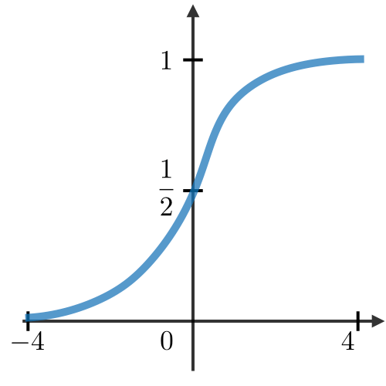
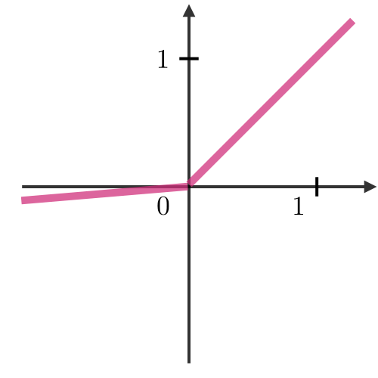
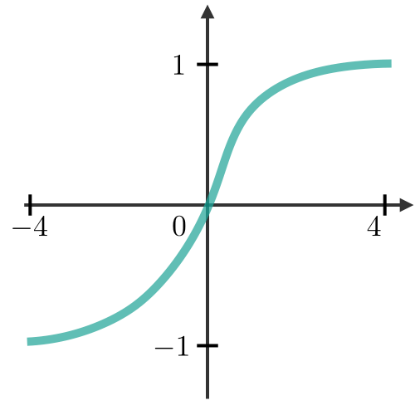
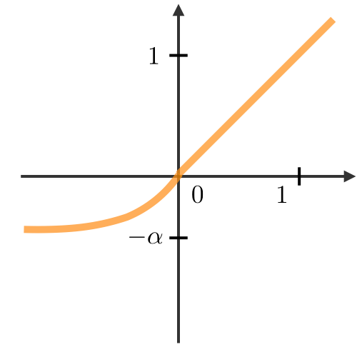
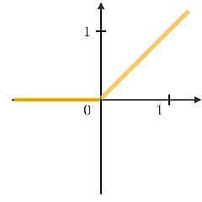
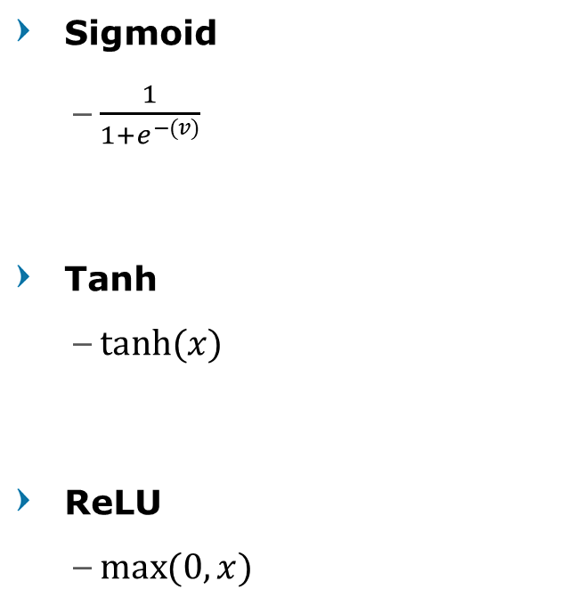


Activation Functions
Sigmoid
$\frac{1}{1+e^{−(v)}}$
Tanh
$\tanh{(x)}$
ReLU
$\max{(0,x)}$
Leaky ReLU
$max(0.1x,x)$
ELU
$\max\left(α\left(e^{z}−1\right), x\right)$
SELU
$\max\left(λα\left(e^{z}−1\right), x\right)$
Computer Vision
Notes:
Usually people use sigmoid/tanh
Relu became popular since 2012, converge much faster, current default recommendation
More : SoftSign, Hardtanh

Slide 25
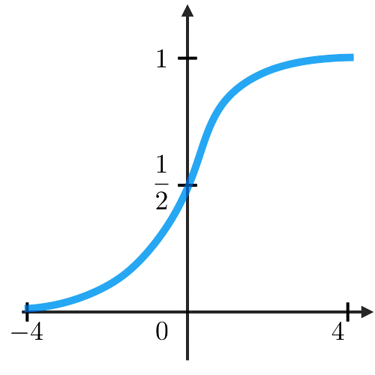
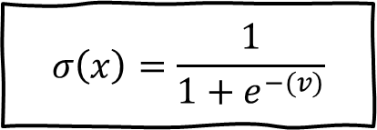

Sigmoid Function
Forward function
Backward function
Squashes numbers to range [0, 1]
Historically popular since they have nice interpretation as a saturating “firing rate” of a neuron
$$σ\left(x\right)=\frac{1}{1+e^{−(v)}}$$
$$σ^{′\left(x\right)}=σ^{\left(x\right)}−σ\left(x\right)2$$
Computer Vision
Notes:
Saturated means neuron that output very close to 0 or 1

Slide 26
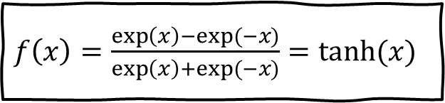

Tanh Function
Forward function
Backward function
Squashes numbers to range [-1, 1]
$f\left(x\right)=\frac{\exp\left(x\right)−exp⁡(−x)}{\exp\left(x\right)+exp⁡(−x)}=tanh⁡(x)$
$$f^{′\left(x\right)}=1−\tanh^{2}{(x)}$$
[LeCun et al., 1991]
Computer Vision
Notes:
Saturated means neuron that output very close to 0 or 1

Slide 27

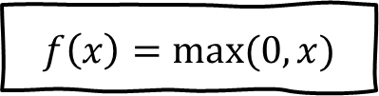
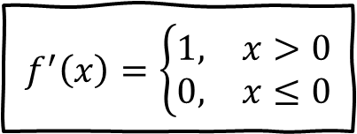
Rectified Linear Unit
Forward function
Backward function
Does not saturate (in +region)
Very computationally efficient
Converges much faster than sigmoid/tanh in practice
$$f\left(x\right)=max⁡(0,x)$$
$$f^{′}\left(x\right)=\left\{\begin{matrix}1, & x>0 \\ 0, & x≤0\end{matrix}\right.$$
[Krizhevsky et al., 2012]
Computer Vision
Notes:
in practice (e.g. 6x)

Slide 28

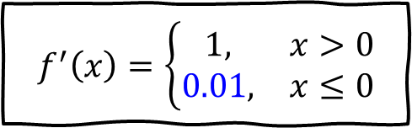
Leaky ReLU
Forward function
Backward function
Try to fix “dead” Neuron in ReLU
Does not saturate; Computationally efficient
Converges much faster than sigmoid/tanh in practice (~6x)
$$f\left(x\right)=max⁡(0.01x , x)$$
$$f^{′}\left(x\right)=\left\{\begin{matrix}1, & x>0 \\ 0.01, & x≤0\end{matrix}\right.$$
[Mass et al., 2013]
Computer Vision

Slide 29

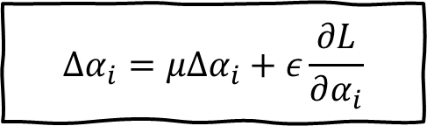
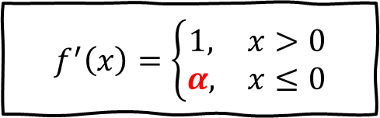

Parametric ReLU
Forward function
Backward function
Parameter $α$ is learnable through backpropagation
$$f\left(x\right)=max⁡(αx , x)$$
$$f^{′}\left(x\right)=\left\{\begin{matrix}1, & x>0 \\ α, & x≤0\end{matrix}\right.$$
$$Δα_{i}=μΔα_{i}+ε\frac{∂L}{∂α_{i}}$$
[He et al., 2015]
Computer Vision

Slide 30

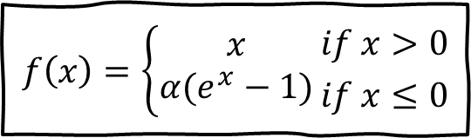
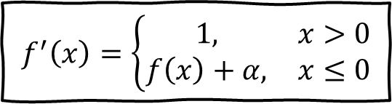
Exponential Linear Units
Forward function
Backward function
All benefits of ReLU
Problem: Computation requires exp()
$$f\left(x\right)=\left\{\begin{aligned}x \\ α(e^{x}−1)\end{aligned}\right.{if x>0 \atop if x≤0}$$
$$f^{′}\left(x\right)=\left\{\begin{matrix}1, & x>0 \\ f\left(x\right)+α, & x≤0\end{matrix}\right.$$
[Clevert et al., 2015]
Computer Vision

Slide 31
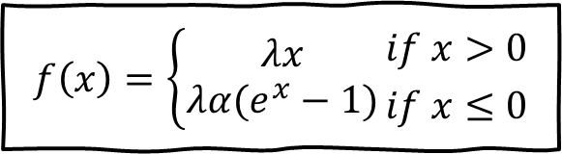
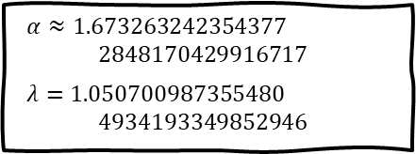
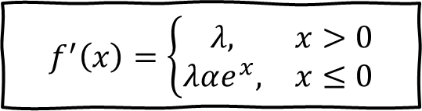
Scaled Exponential Linear Units
Forward function
Backward function
Scaled version of ELU that works better for deep networks
“Self-Normalizing” property
$$f\left(x\right)=\left\{\begin{aligned}λx \\ λα(e^{x}−1)\end{aligned}\right.{if x>0 \atop if x≤0}$$
$$f^{′}\left(x\right)=\left\{\begin{matrix}λ, & x>0 \\ λαe^{x}, & x≤0\end{matrix}\right.$$
$α≈\text{1.}\text{673263242354377} \text{2848170429916717}$
$λ=1.050700987355480$ $4934193349852946$
[Klambauer et al., 2017]
Computer Vision

Slide 32
More of ReLU
Randomized leaky ReLU (RReLU)
S-shaped ReLU (SReLU)
Adaptive piecewise linear (APL)
Computer Vision

Slide 33
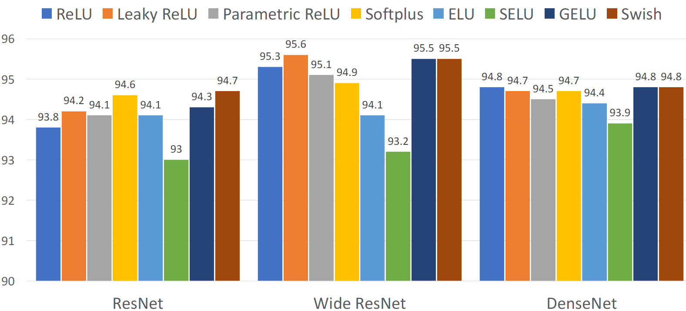
Accuracy on CIFAR10
Computer Vision

Slide 34















Why use Activation Function?
Without activation function, the neural network will be just a single linear sandwich
The capacity is the same as just a linear classifier
$$x$$
$$w_{1}$$
$$a$$
$$w_{2}$$
$$y$$
$$x$$
$$w_{1}∗w_{2}$$
$$y$$
$$∗$$
$$=$$
$$∗$$
$$=$$
$$≡$$
$$∗$$
$$=$$
Computer Vision

Slide 35
Break, Question?
Computer Vision

